Slide 1

VOICE FINGERPRINTING
Team Members : 218CO14 Anand
335CO14 Sachet Ganwal
362CO14 Shubham Yadav
Guide: Bijendra Kumar Singh

Slide 2
Problem Statement
To develop a voice fingerprinting system to determine a speaker's profile(forensic analysis,age/geographical identification,accent identification).
In the recent world of technology, there are many methods to determine the individuality of a person. One of them is the voice – unique individual characteristic. Each person‘s voice is different because the anatomy of the vocal cords, vocal cavity, oral and nasal cavities is specific to the individual. Comparison of two recorded speech by means of spectrogram or voice prints for the purpose of identification is called as Voice fingerprinting.

Slide 3
Previous Work
“Automatic Accent Recognition Systems and the Effects of Data on Performance”
- By Georgina Brown
“Accent Identification”
- By Carlos Teixeira, Isabel Trancoso and António Serralheiro“Accent
“Accent Identification by Clustering and Scoring Formants”
- By Dejan Stantic, Jun Jo
“Voice Fingerprinting: A Very Important Tool against Crime”
- By Pragnesh Parmar

Slide 4
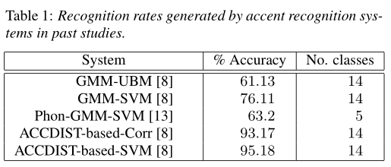
Automatic Accent Recognition Systems and the Effects of Data on Performance
Forensic speech scientists may benefit from the output of an automatic accent recognition system when tending to speaker profiling tasks. Speaker profiling is the task of drawing information about an unknown speaker from a recording. This information might be a speaker’s age or geographical origin.

Slide 5
Accent Identification by Clustering and Scoring Formants
Keywords—Accent Identification, Formants, Q Factor.
Existing systems still face difficulties, particularly when used by non-native speakers with accents. In this paper we address a problem of identifying the English accented speech of speakers from different backgrounds (Indian, Chinese, Croatian, Korean).
The term formant refers to spectral peaks in the harmonic spectrum of a complex sound. Formants in the sound of the human voice are particularly important because they are essential components to distinguish vowel sounds.

Slide 6
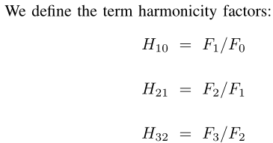
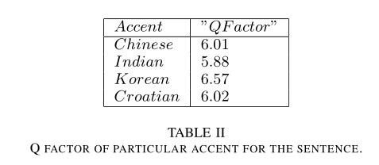
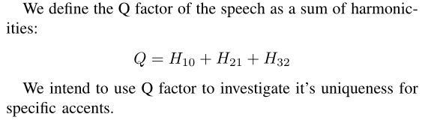

Slide 7
Voice Fingerprinting: A Very Important Tool against Crime
Key Words: Voice fingerprinting, Forensic phonetics, Sound spectrogram.
The spectrograph‘s printout is called a spectrogram. Each spectrogram shows 2.5 seconds of spoken sounds, represented as a graph.
The spectrogram shows the frequencies of both fundamentals and harmonics.
At the end of the examination, the analyst reaches one of five conclusions: The samples definitely match, the samples probably match, the samples probably do not match, the samples definitely do not match, or the test was inconclusive.
An analyst must find 20 points of similarity and no unexplainable differences in order to declare a definite match. A definite non match requires 20 or more differences between the two tapes.

Slide 8
Approach: The task of speaker recognition can be considered as a task of classification. Thus a number of machine learning techniques can be applied to this task. In general, this task should cover the following three topics:
Feature Extraction: Process the voice signal and extract acoustic features that could describe the acoustic characteristics of speakers, which can be correlated in some extend to model latter used.
Acoustic Model: Provide the functionality of registration as well as identification or verification.
Evaluation: Evaluate our approach using datasets with appropriate metrics.

Slide 9
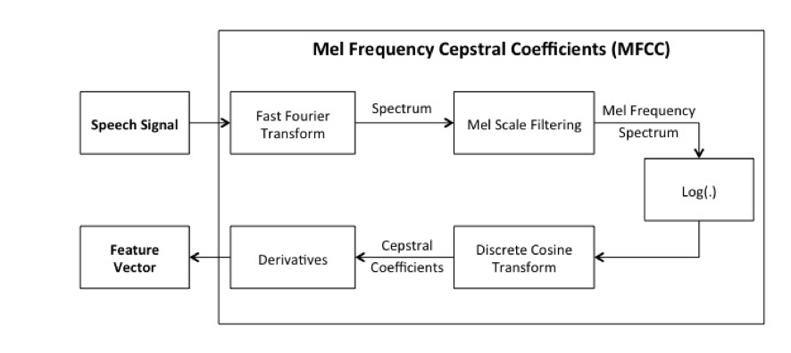
1. Feature Extraction: The task of speaker recognition is highly correlated to the task of speech recognition. In the field of speech recognition, Complex Cepstrum is considered to be a concise description to the original acoustic signal. In particular, Mel-frequency Cepstral Coefficients (MFCC), is a state-of-the-art standard feature widely used in Automatic Speech Recognition (ASR) system. The general procedure for calculating MFCC is as follows:

Slide 10
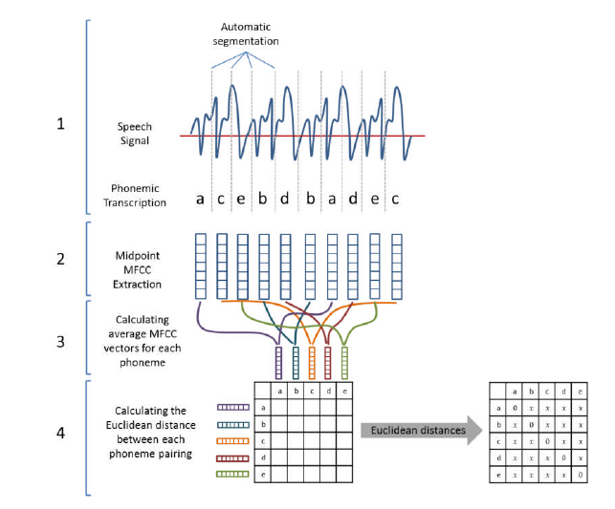
Accent Modelling

Slide 11
2. Model:
According to works in years, Gaussian Mixture Model (GMM) has been a common approach to acoustic modelling. GMM can be used to acquire an acoustic model P(O|W), which gives the probability of a given observation O under certain word W. By using GMM, this conditional probability can be well estimated by modelling the distribution as a sum of several normal distribution.
In addition to that, Hidden Markov Model (HMM) is a main-stream approach in ASR system, since it can describe sequential relation of observations. We have noticed a few research-oriented open-source speech recognition tool building on HMM, such as HTK. Such tools might be quite useful in building a speaker recognition system.
Recently, some common machine learning model are also applied to the task of speaker recognition suggested a method of using SVM in speaker recognition. Deep neural networks are also used in speech processing recently.
SVM will probably be our first attempt, as it is proven to be efficient and effective. We might also try to migrate our extracted feature to some other available models.

Slide 12
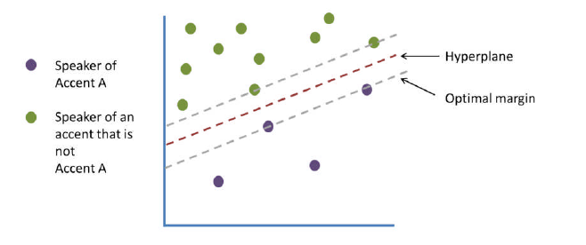
Support Vector Machine(Accent Classification)

Slide 13
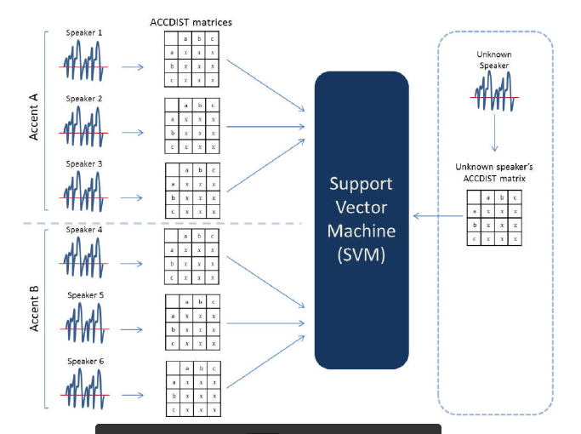

Slide 14
References:
William M Campbell et al. “Support vector machines for speaker and language recognition”. In: Computer Speech & Language 20.2 (2006), pp. 210–229.
Cepstrum - Wikipedia, the free encyclopedia. url: http : / / en . wikipedia . org / wiki /Cepstrum.
John Godfrey, David Graff, and Alvin Martin. “Public databases for speaker recognition andverification”. In: Automatic Speaker Recognition, Identification and Verification. 1994.
Xuedong Huang, Alejandro Acero, Hsiao-Wuen Hon, et al. Spoken language processing. Vol. 15. Prentice Hall PTR New Jersey, 2001.
Richard J Mammone, Xiaoyu Zhang, and Ravi P Ramachandran. “Robust speaker recognition: A feature-based approach”. In: Signal Processing Magazine, IEEE 13.5 (1996), p. 58.
Douglas A Reynolds. “Experimental evaluation of features for robust speaker identification”. In: Speech and Audio Processing, IEEE Transactions on 2.4 (1994), pp. 639–643.
Douglas A Reynolds and Richard C Rose. “Robust text-independent speaker identification using Gaussian mixture speaker models”. In: Speech and Audio Processing, IEEE Transactions on 3.1 (1995), pp. 72–83.
Speaker Recognition - Wikipedia, the free encyclopedia. url: http://en.wikipedia.org/wiki/Speaker_recognition.

Slide 15
Thank
You

